Slide 1
Statistics for MLRA Soil Survey
Presented by: Tom D’Avello, Skye Wills, and Katey Yoast

Slide 2
Statistics for MLRA Soil Survey
Webinar objectives
Step back and review some basics
Gentle introduction to R
Link to packages developed and presented earlier – soilDB, AQP
Why is R on your machine?
The cost is right
The functionality is huge
The user base is large
Shift in NCSS effort from inventory to refinement, synthesis, correlation
Prelude to development of training class in “Statistics for Soil Survey”
A comprehensive course in statistics, geared to soil survey applications, built around the R environment. The goal is to develop a working knowledge of quantitative techniques that will be increasingly employed in the future.
Notes:
Tom

Slide 3
Statistics for MLRA Soil Survey
Why is the training needed?
Opportunities to learn these techniques is limited at the undergraduate level
Long standing goal of the SSD to have a course in statistics
There will be a greater need to use these tools for current and future duties
Mapping of unmapped federal lands via Digital Soil Mapping techniques
Consistently characterize/classify Ecological Site products
Soil survey refinement (disaggregation)
Consistent methods for determining and populating database
Consistent methods for evaluating data – correlation, design of study/investigation
Where can “Statistics for Soil Survey” be found? http://www2.gru.wvu.edu/~tdavello/files/stats/table_of_contents.html
The final site may change, but this will be the repository for the foreseeable future
Purpose of “Statistics for Soil Survey” web page?
Notes:
Tom
Training pathways for soil scientists were started and completed in the mid-2000s.
Statistics was identified as a need, getting to fulfilling that need now
The web page is meant to serve as a continual base-line source of information, much like a text book, but streamlined to the needs and activities in soil survey
For those that may go months without using or thinking about statistics

Slide 4
The Data We Use
Data Type refers to the measurement scale used. There are four measurement scales, in decreasing order of precision:
Ratio - Measurements having a constant interval size and a true zero point, e.g. length, weight, volume, rates, counts of items, temperature in K
Interval - Measurements having a constant interval size but no true zero point. Examples include Temperature (C, F), direction (e.g. slope aspect), time of day. Specific statistical procedures are available to handle circular data like slope aspect.
Ordinal - Members of a set are differentiated by rank. Examples include Soil interpretation classes (e.g. slight, moderate, severe), suitability (e.g. good, fair, poor)
Nominal (Categorical) - Members of a set are differentiated by kind, e.g. land cover classes, soil map units, geologic units
Data Type controls the choice of statistical operation.
Notes:
Tom

Slide 5
The Data We Use
Continuous Data - Any measured value. Data with a possible value between any observed range. For example, the depth to high chroma mottles could range from 30cm to 40cm, with an infinite number of values between, limited only by the precision of the measurement device
Discrete Data - Data with exact values. For example, the number of Red spruce seedlings observed in a square meter plot, the number of legs on a dog, the presence/absence of a feature or phenomenon
Notes:
Tom

Slide 6
The Data We Use
Accuracy and Precision
Accuracy - the closeness of a number to its actual value
Precision - the closeness of repeated measurements to each other
Significant Figures
The digits in a number that define the accuracy of a measurement.
6 cm has one significant digit with an implied range of 1 cm. The true value lies between 5.50 and 6.49.
6.2 cm has two significant digits with an implied range of 0.1 cm. The true value lies between 6.150 and 6.249.
The implied accuracy is greater for the number 6.0 cm than 6 cm.
Notes:
Tom

Slide 7
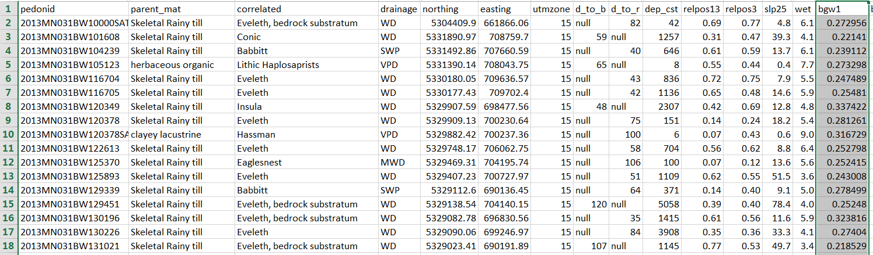
Preparing Data for Use in R
Think 1 record/observation per row with 1 or more comma delimited attributes and the first row as a header.
Example of georeferenced soil observations and associated GIS data suitable for use in R:
Notes:
Tom
This data was populated using Extract multivalues to points in ArcGIS

Slide 8
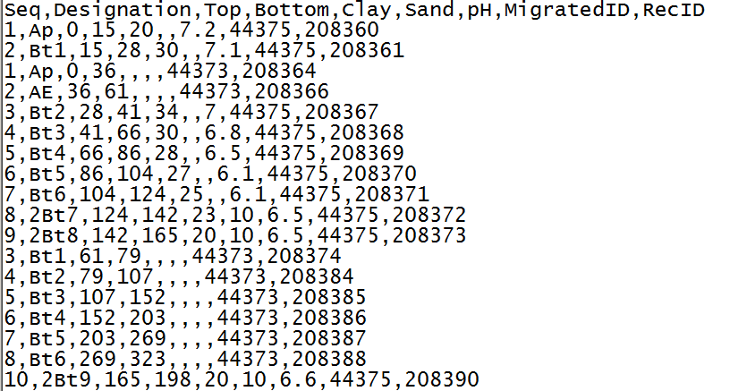
The Data We Use
Example of subset of soil horizon data suitable for use in R:
Notes:
Tom
This data was gleaned from NASIS

Slide 9
The Data We Use…
Are complex, have one to many relationships
Are sometimes stored in multiple databases and formats
Are tabular and spatial
Often contain outliers and nonlinear distributions
Require tacit knowledge for data analysis
Quantifiable, repeatable data analysis is needed to populate soil survey data. R, in conjunction with other software, is an invaluable tool for achieving this level of analysis.
Notes:
Tom

Slide 10
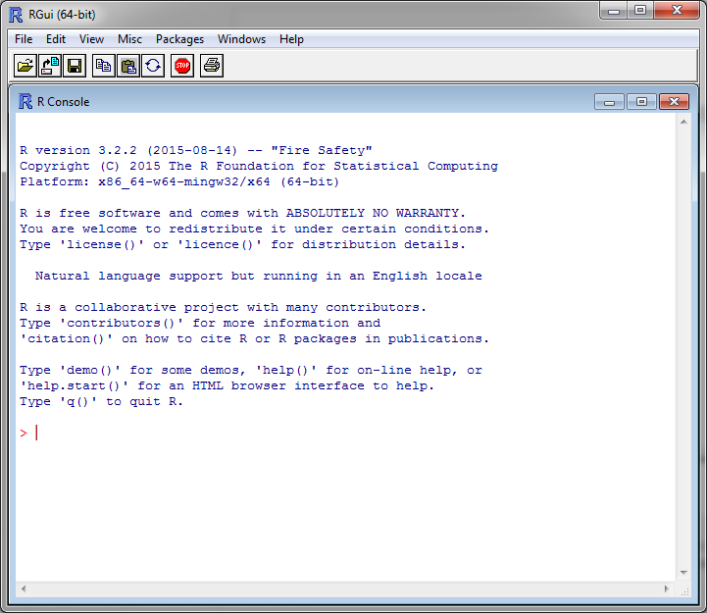
R GUI
Notes:
Katey
Thanks Tom. So let’s go through a short tutorial on how to actually use R. Unless you have been to grad school recently or have ventured on your own, you probably haven’t used R all that much, but it probably already installed on your machine, especially if you have a NASIS log-in. There are two R programs can be found using the start>all programs menu at the bottom left hand portion of your screen: R and Rstudio. Both programs are command line driven that allow graphical display. Rstudio is generally viewed as more user friendly and intuitive and is therefore recommended.
I’ve had the opportunity to talk with several of you that have used R and that is great – this tutorial will serve as a refresher on the uses of R and will be a good starting point for beginners! The material that I am about to cover is also covered in the first chapter of the stats for soil survey resource that Tom shared with you earlier.
If you open the R program on your machine, you will see the R Console window that displays the version of R that you are working in.

Slide 11
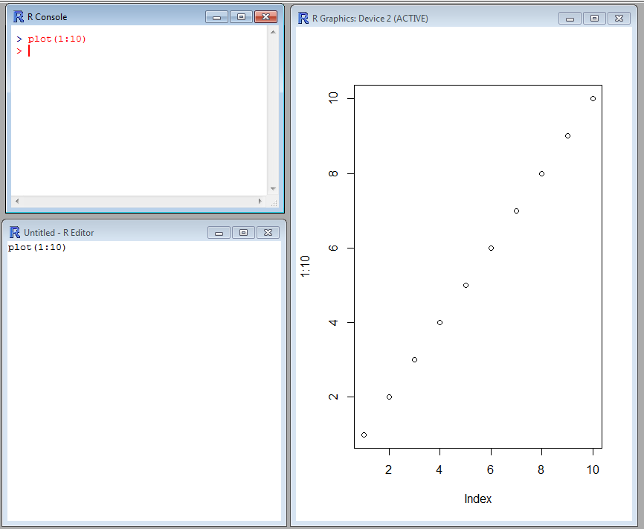
R GUI
R Console:
R code is typed here when it is ready to be executed.
R Graphics:
Graphics are displayed in this window after plot() or another graphics function is executed in R Console.
R Editor:
R code is typed here when it is in the process of being edited (you can also use notepad, notepad ++, etc.).
Notes:
Katey
There are three main windows in R that you can use to conduct your data analysis: R Console, R Editor, and R Graphics. The R Editor window is simply a text editing window, you may also use notepad or notepad ++. The R Graphics window will only display when a command such as plot ( ) is executed.

Slide 12
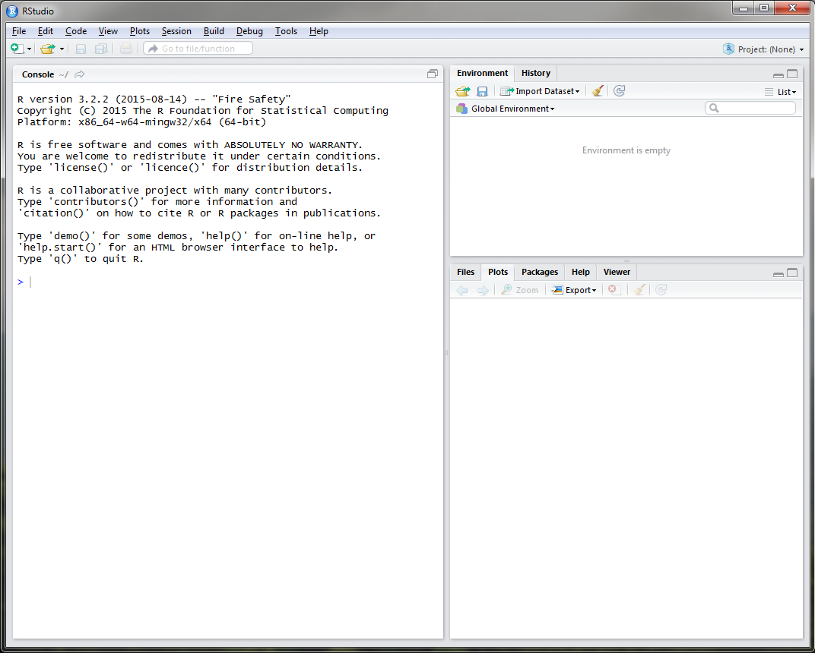
RStudio
Notes:
Katey
R studio is similar to R GUI, but is more user friendly. When you open Rstudio on your machine, you will see 3 windows: the console window, just like in the R GUI and two other windows composed of multiple tabs. The upper right window has two tabs: environment and history. The environment tab will keep track of the datasets that you import and objects that you create.

Slide 13
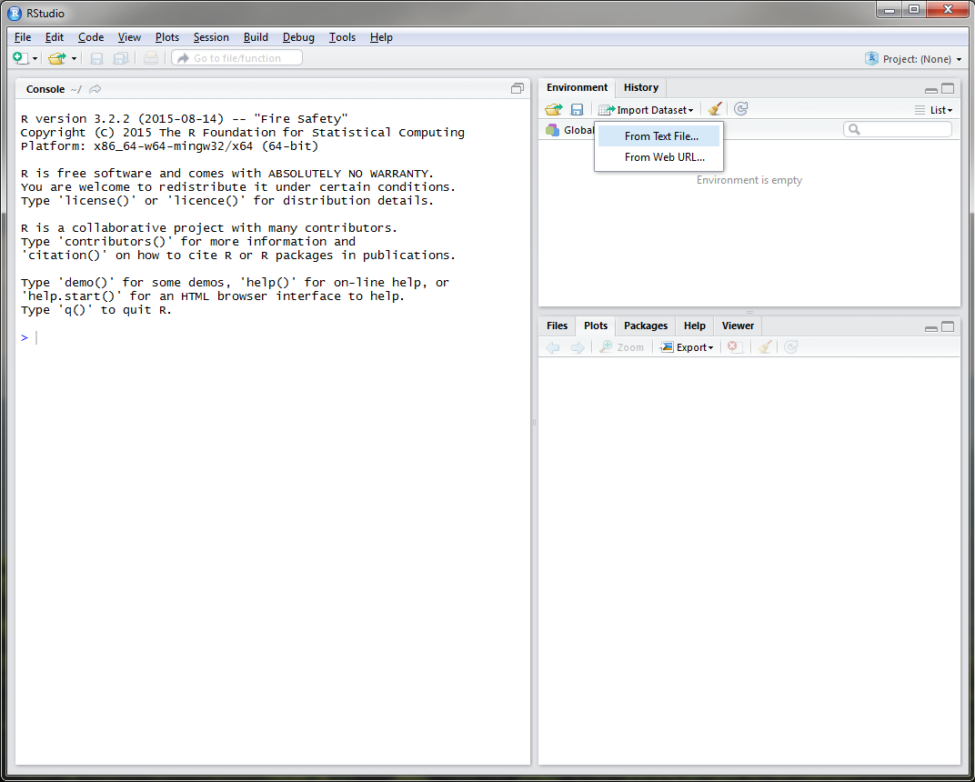
RStudio
Notes:
Katey
You can also import a dataset using the Environment Tab.

Slide 14
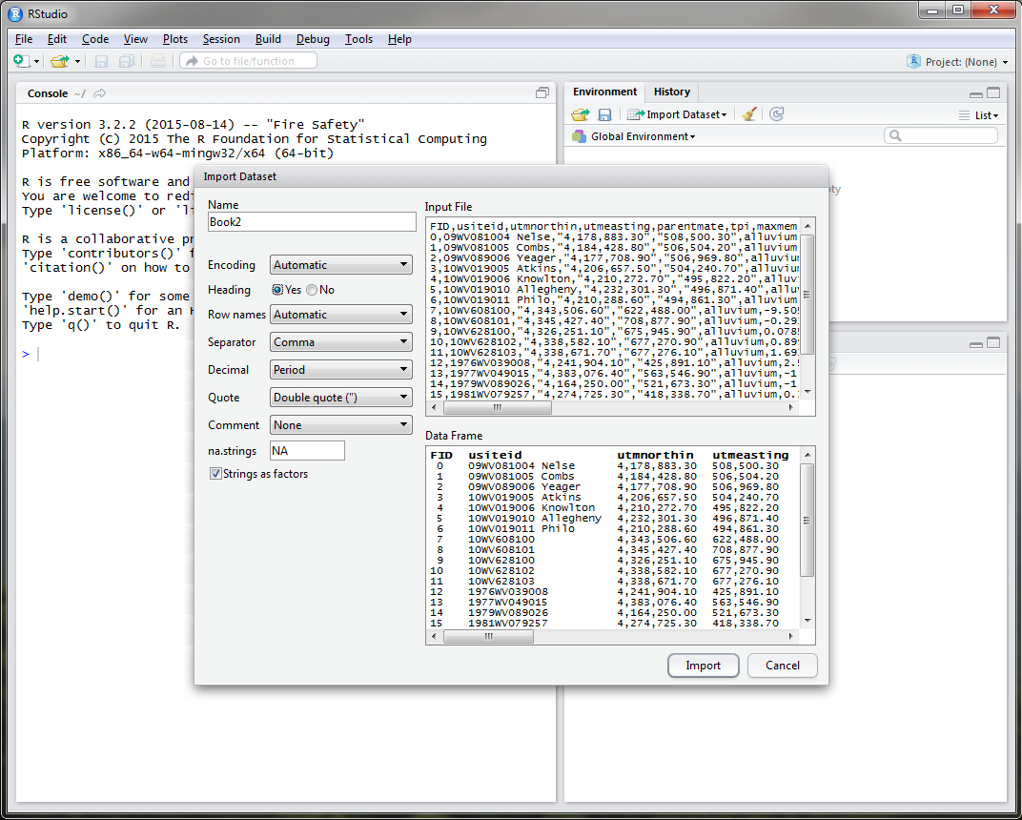
RStudio
Notes:
Katey

Slide 15
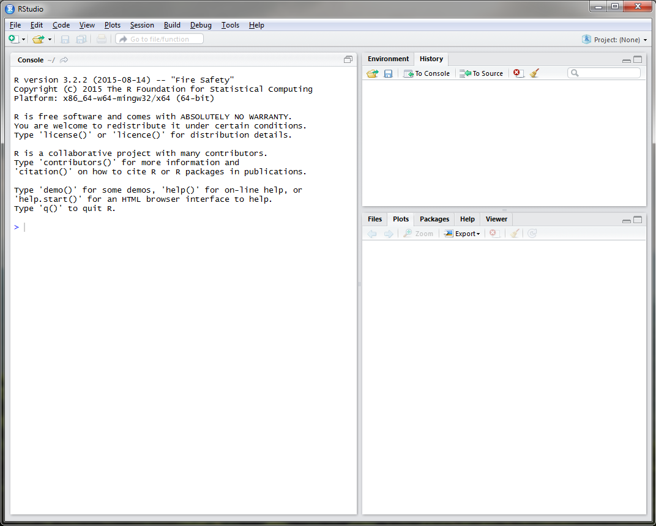
RStudio
Notes:
Katey
The History tab will display a history of all of the commands you’ve executed during your Rstudio session.

Slide 16
RStudio
Notes:
Katey
The bottom right window is composed of 5 tabs which I will go into a little bit later in the presentation.

Slide 17
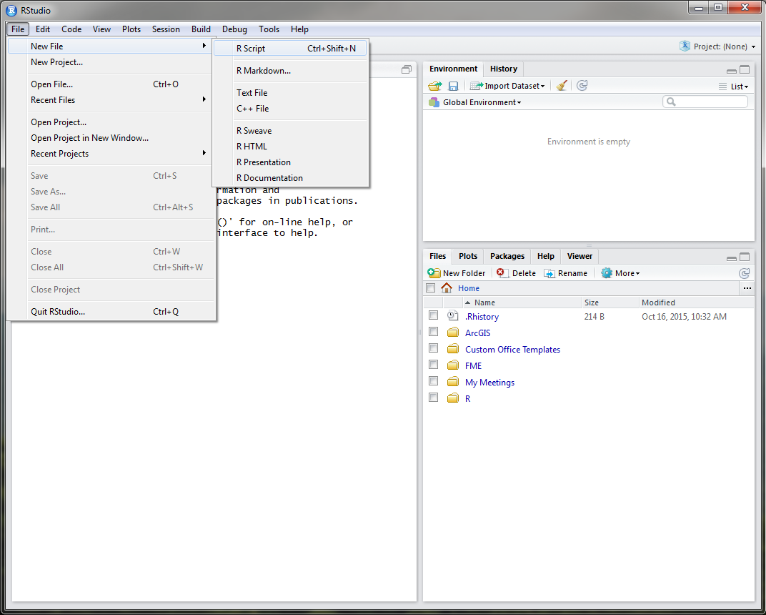
RStudio
Notes:
Katey
The text editor window in Rstudio can be opened using the File drop down menu.

Slide 18
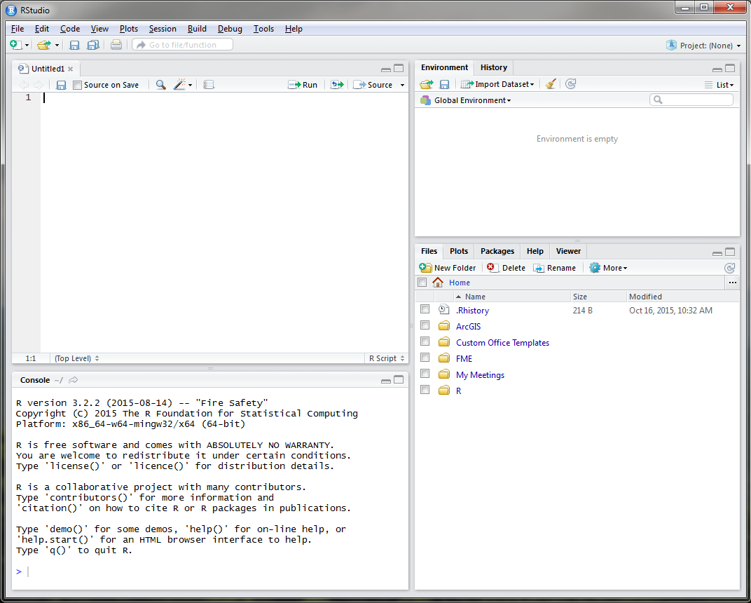
RStudio
Notes:
Katey
It is recommended to use the text editor window to develop your code before executing it in the console window.

Slide 19
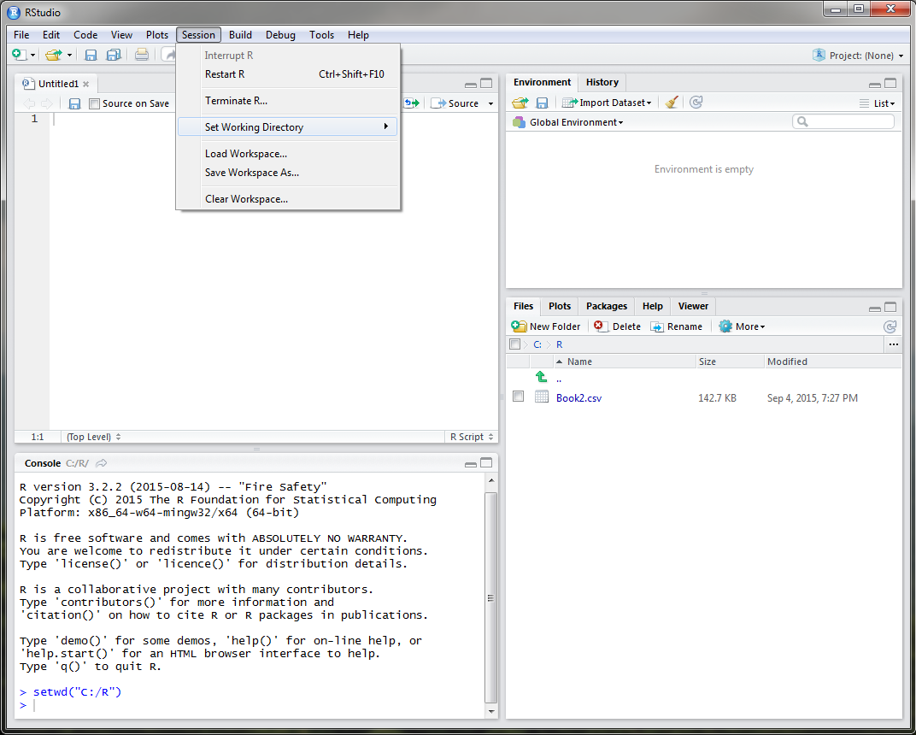
RStudio
Notes:
Katey
At the beginning of each R session, whether you are using R or Rstudio, you want to make sure that you set your working directory. This directory should be where your input datasets are stored, R files are located, and will also serve as the default storage of plots or exported objects from R. To do this in Rstudio, simply use the Session drop down menu. Notice that once you set your working directory, the Files tab in the bottom right window navigates to the directory that you specified, in this example, a folder called R on the C drive.

Slide 20
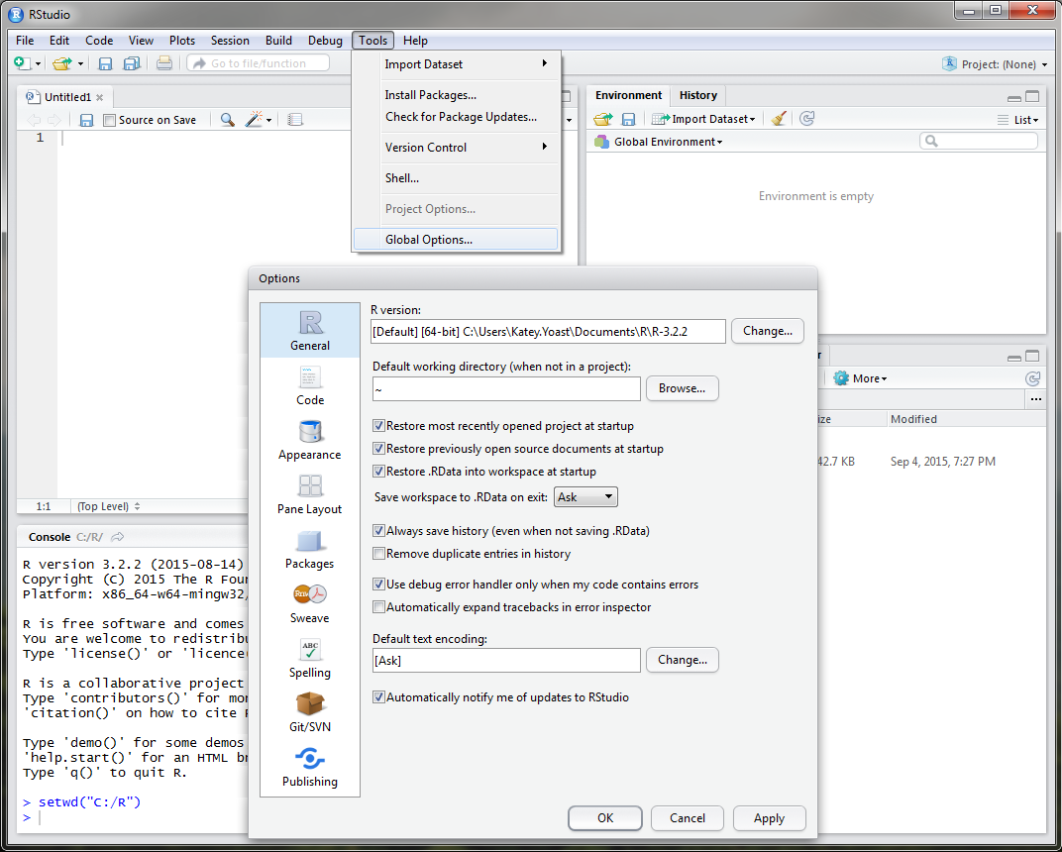
RStudio
Notes:
Katey
There are more advanced settings available in Rstudio regarding saving R files and setting global directories under the Tools drop down menu that I don’t want to get into to today. I just wanted to show you the defaults in Rstudio. When you close Rstudio, Rstudio will automatically save you text editor code, history, datasets, etc. : It is always a good idea to err on the safe side tho and save your text, plots, history, and R project at the end of each session. This will also allow you to send these files to others or use on a different machine at a later point.

Slide 21
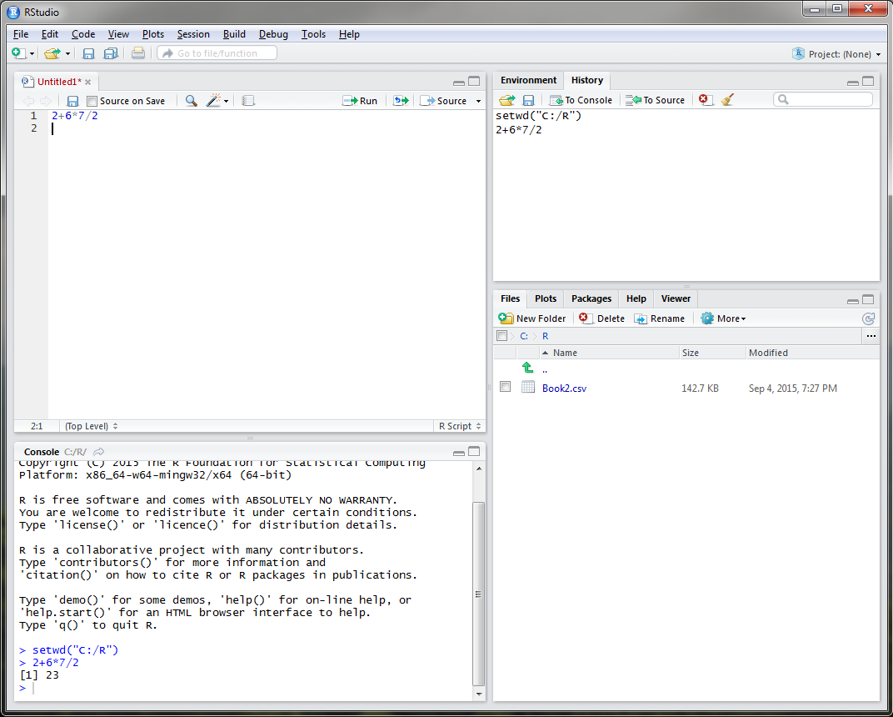
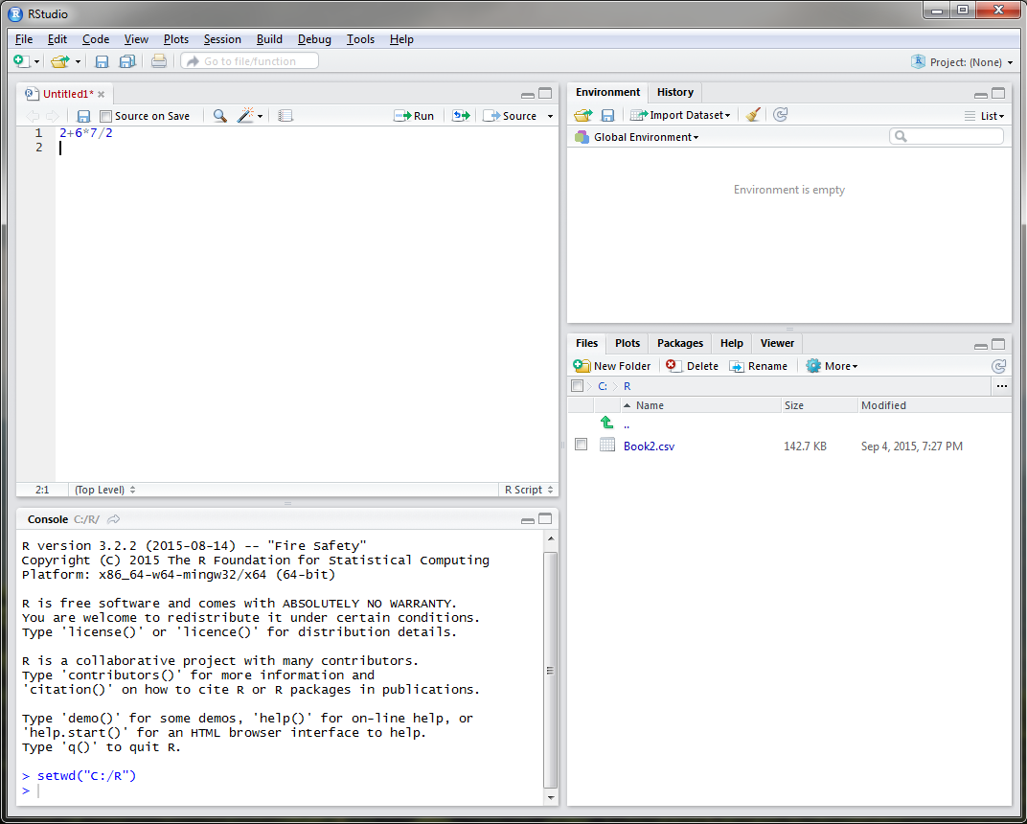
RStudio
Notes:
Katey
R can be used as a calculator to solve simplistic mathematical equations like the one currently displayed, as a GIS, for statistical analysis, for sampling design, and for modeling. In order to execute the equation that I have typed, I must place my cursor on line 1 or highlight line 1 and select the Run button.
-Click-
Notice that the answer to my equation is displayed in the console window in the bottom left and the command is added to the History tab.

Slide 22
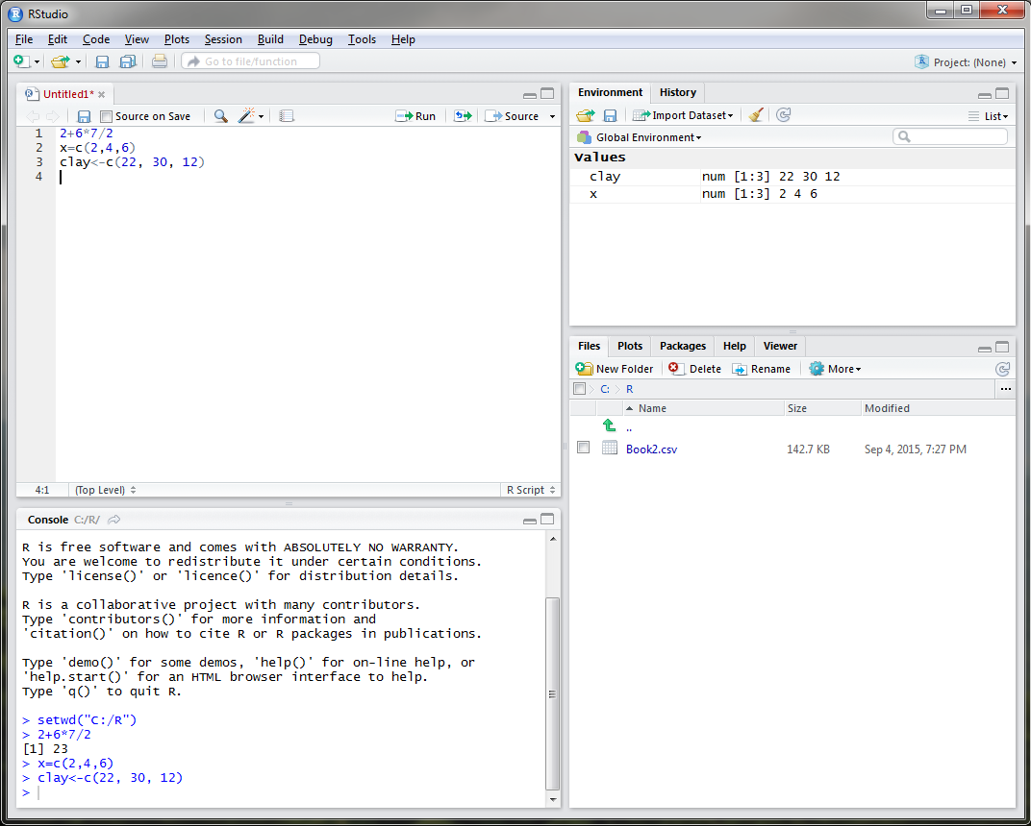
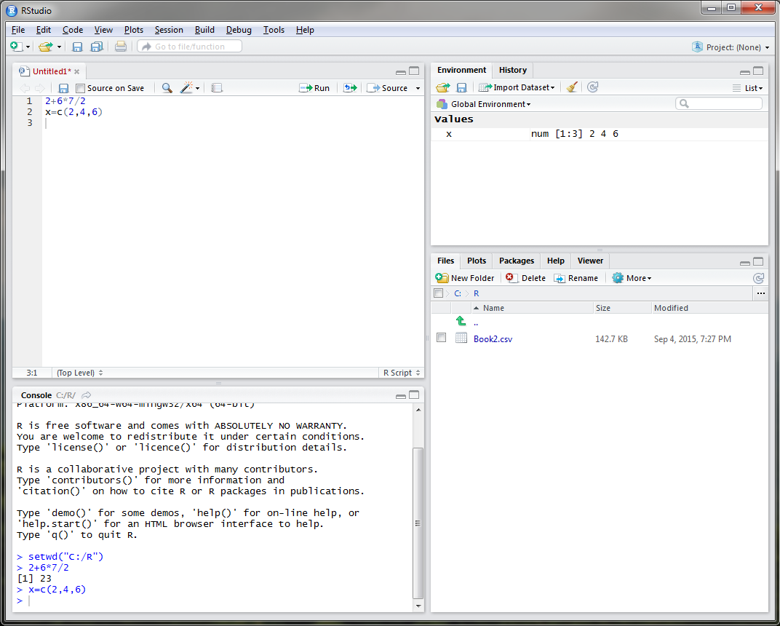
Rstudio - Objects
Notes:
Katey
In R you can assign almost anything as an object, including a single number or letter, model, settings, or dataset. For example, say I wanted to create an object entitled x that displayed rock fragment content of 3 different sites. I could do this in R by typing, x equals the concatenate function that links together the rock fragment values of 2, 4, and 6. Objects are displayed in the Environment tab in the upper right corner. In order to create an object in R, you must use either the = sign or a less than with a dash, either is fine. It is personal preference.
-Click-
Let’s create an object called clay to represent the clay content at these three sites.

Slide 23
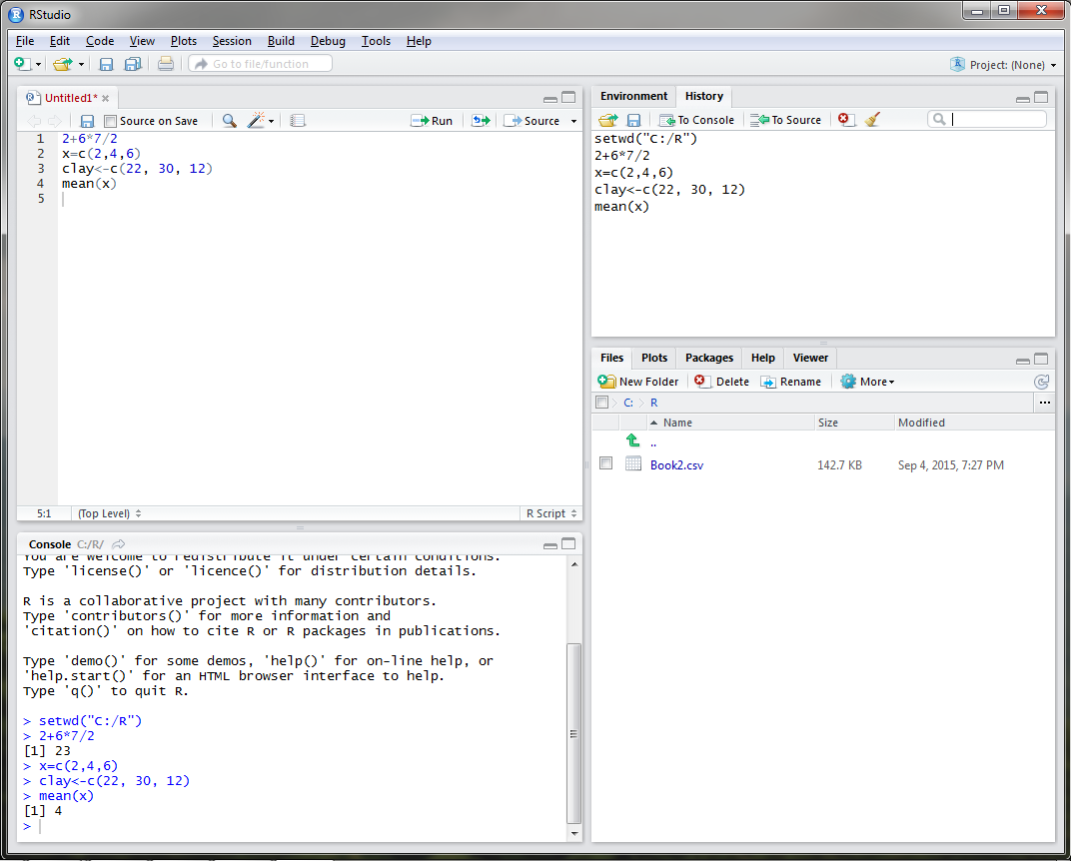
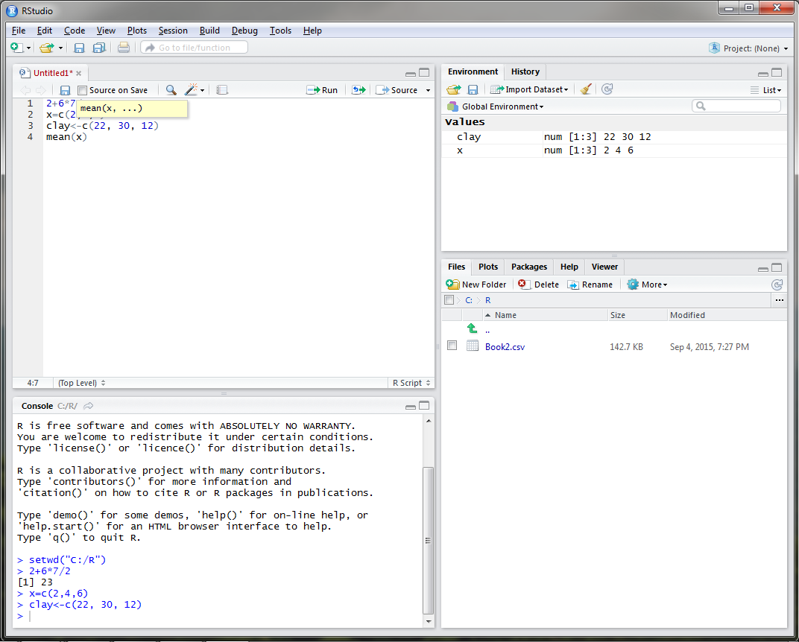
RStudio
Notes:
Katey
Say we wanted to know the mean of our rock fragment content. The function for mean is conveniently mean in R, so you would type mean with x (our rock fragment dataset) in parenthesis.
-Click-
Once you run this command, the answer is displayed in the console as 4 and the function is added to the R history tab. When you type a function in Rstudio, a drop down menu will open that will list all available functions with the term that you type.

Slide 24
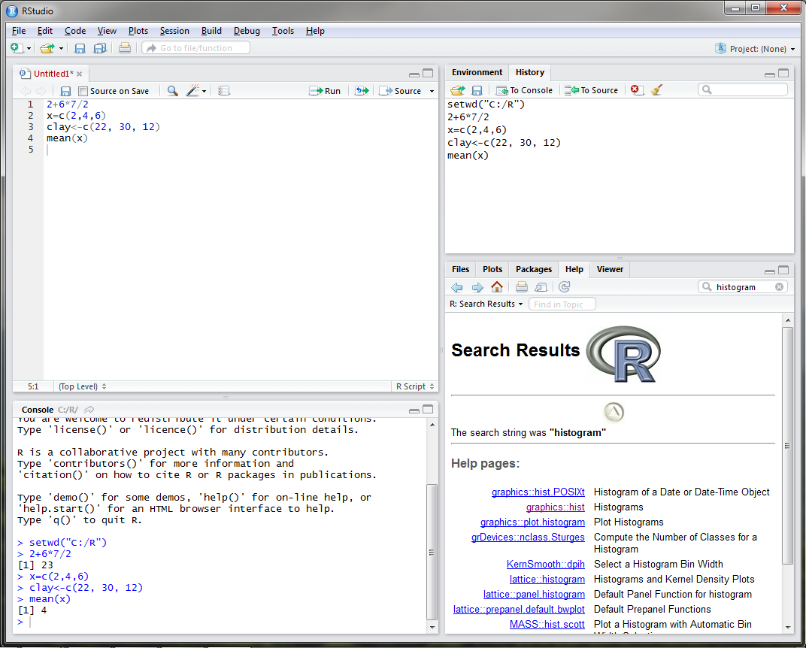
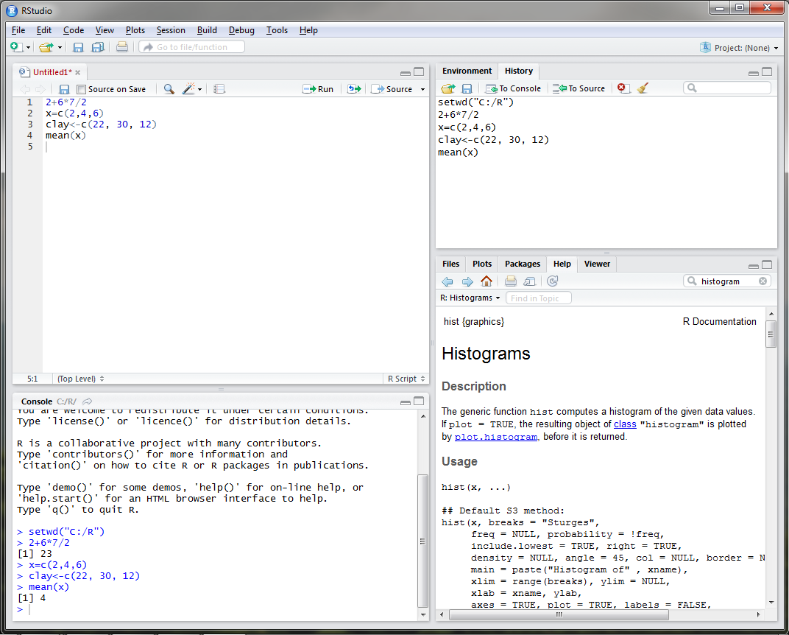
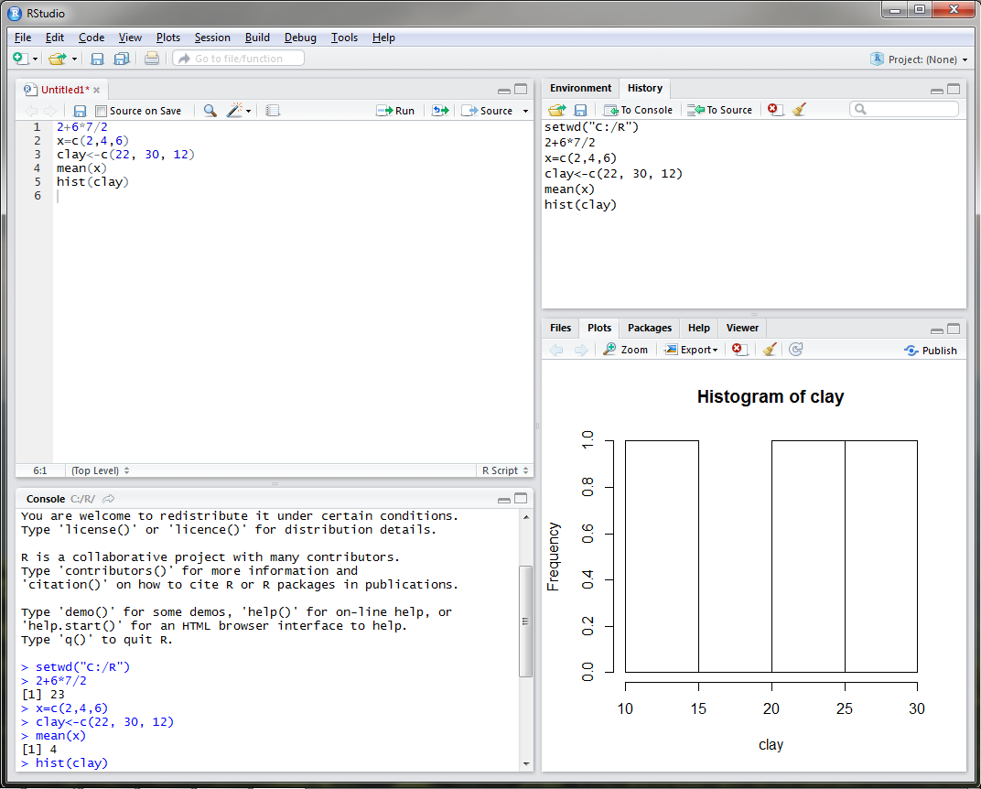
RStudio
Notes:
Katey
What if I wanted to view the distribution of clay content? What function would I use? If I was unsure, I could use the Help tab in the bottom right and search for histogram.
-Click-
If I click on the graphics: hist link, a webpage describing the hist function appears.
-Click-
If I execute the hist command for clay content, you can see that a plot is generated in the plot tab in the bottom right.

Slide 25
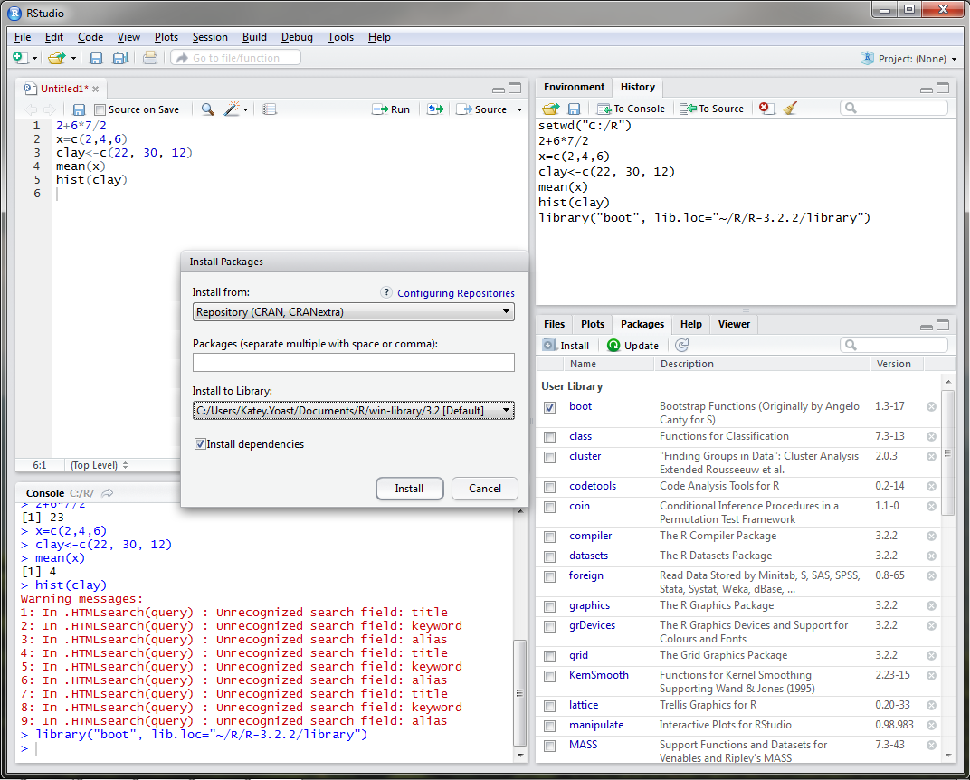
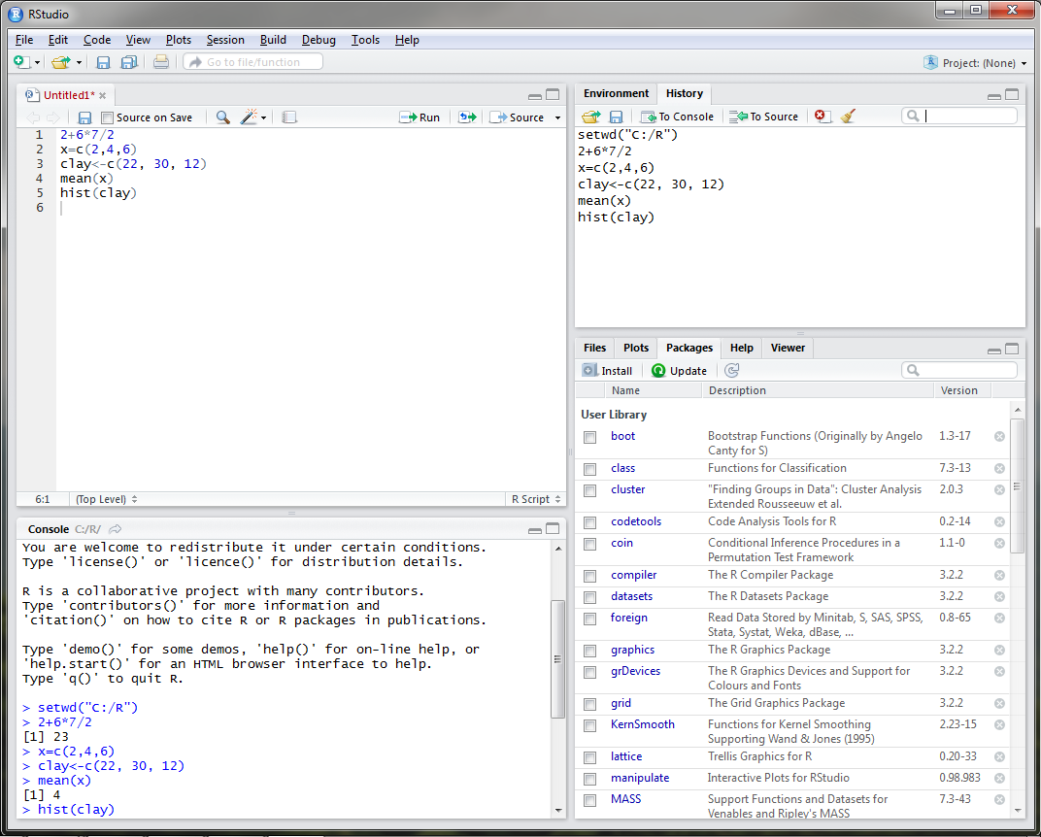
Rstudio – Installing Packages
Notes:
Katey
One thing that I have yet to mention is that both R programs are equipped with base packages that contain functions such as hist and mean. Packages are simply collections of code developed by R users. There are currently over 7,300 packages developed for use in R. For user convenience, Rstudio developed a Packages tab in the lower right window of the most commonly used packages. In order to utilize these packages, the user must select the check box next to the desired package and select install. –Click-

Slide 26
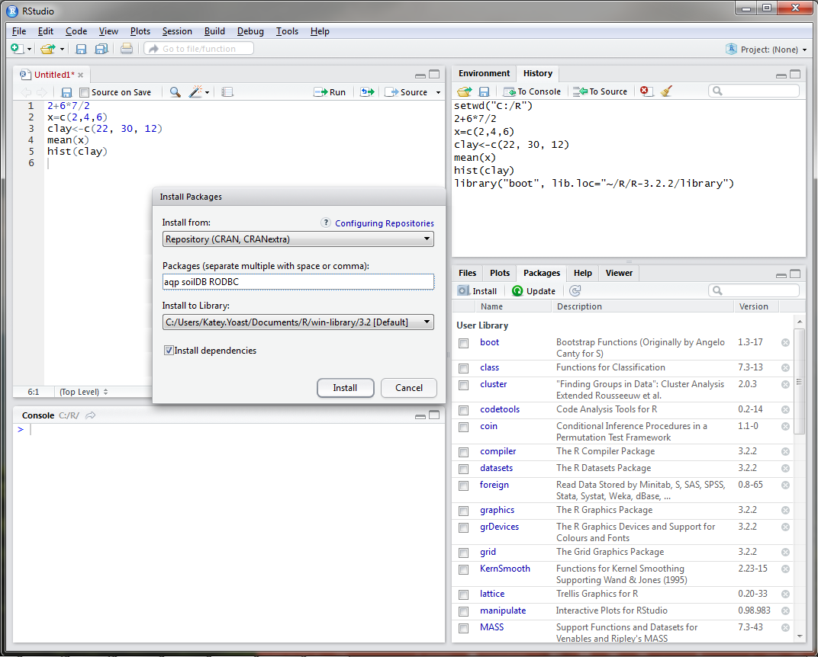
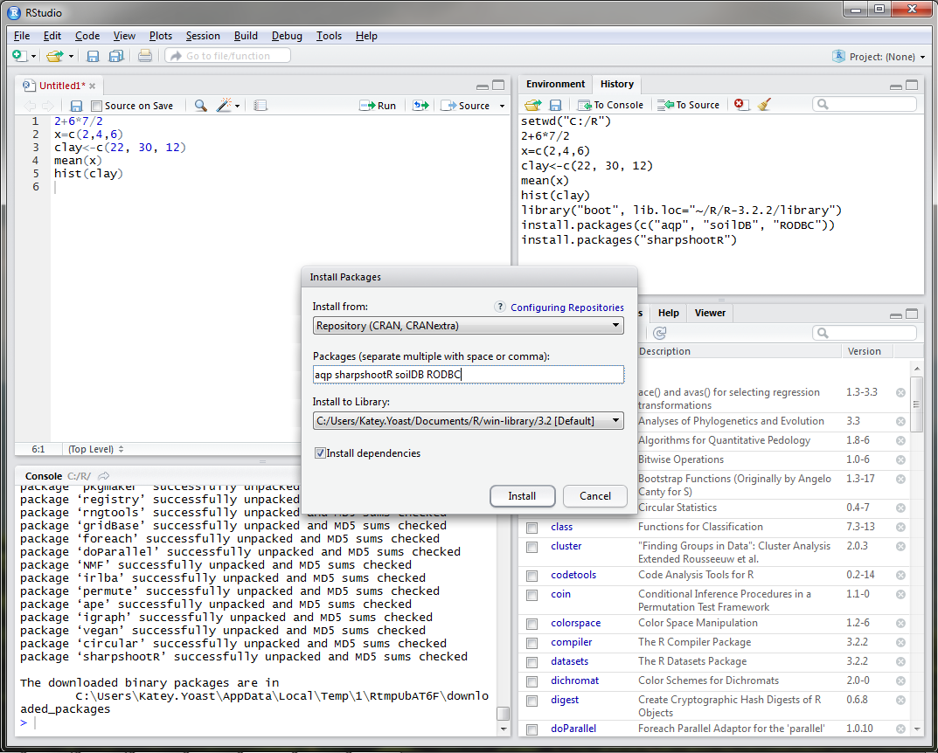
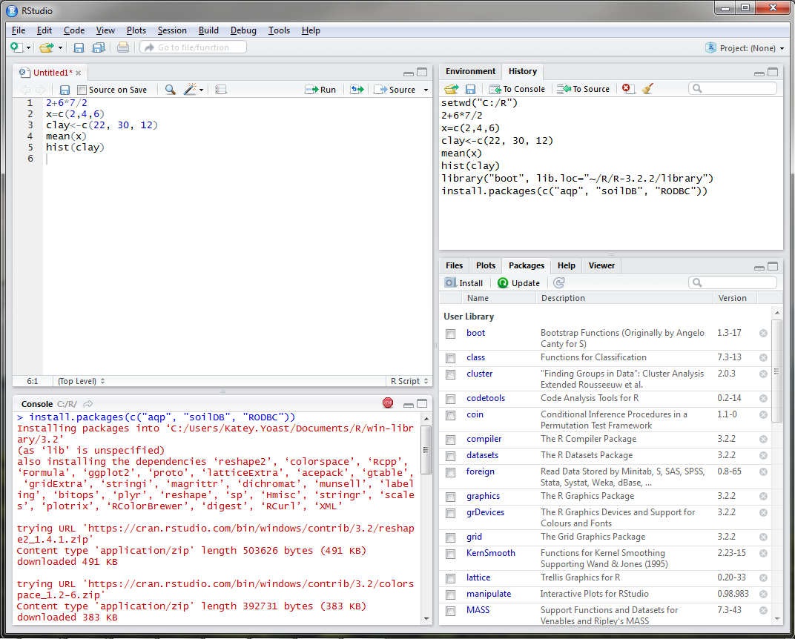
Rstudio – Installing Packages
Notes:
Katey
It may be necessary to install several packages that are not listed under the Packages tab. With no packages selected, click on Install under the Packages tab. In the packages text line, we will type four packages that have been used for soil survey applications, the aqp, sharpshootR, soilDB, and RODBC packages. Packages only need to be installed the first time you use them on your machine.
-Click-
Notice that the packages that we have installed depend and utilize many other packages that were also installed on our machine. It is important to always check the install dependencies box when installing a package in R.
AQP – visualization, aggregation, classification
soilDB – access to commonly used soil databases
SharpshootR – misc. soil survey specific functions
RODBC - ODBC Database Access

Slide 27
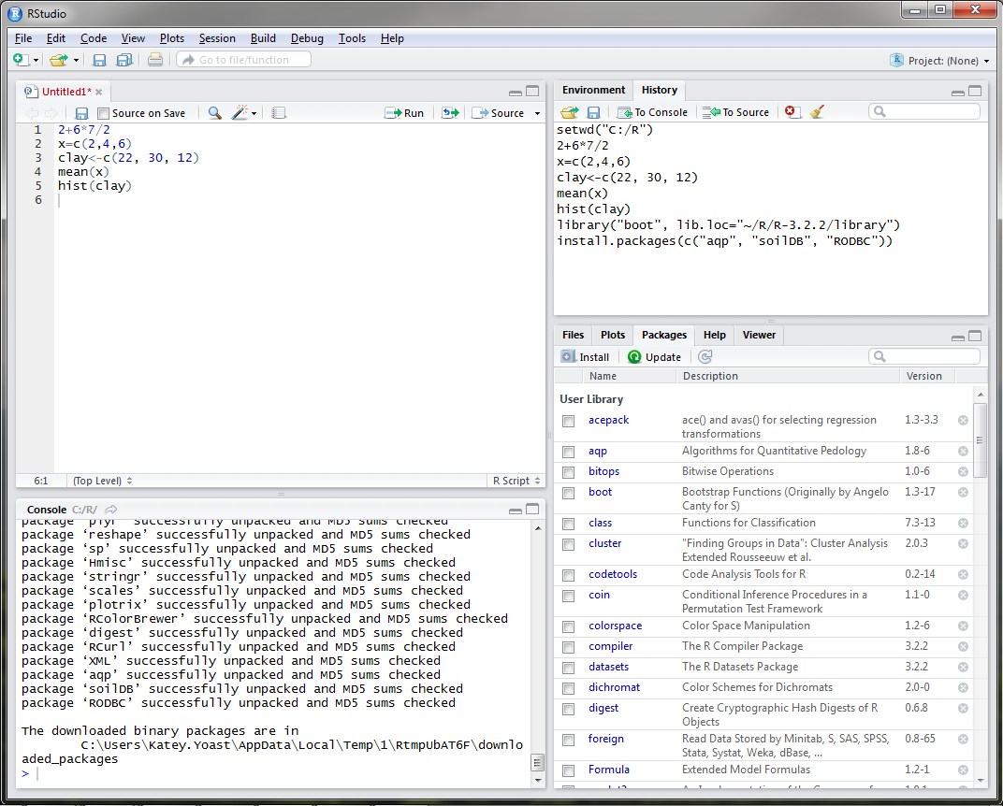
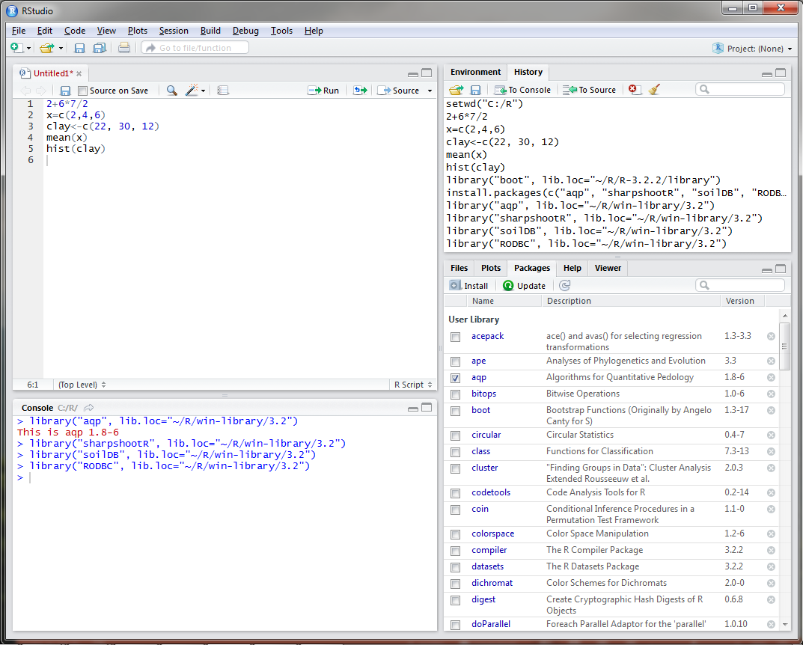
Rstudio – Installing Packages
Notes:
Katey
Once installed, the packages are added to the Package tab in the bottom right corner. You can update packages when necessary by selecting the check box next to the package name and clicking on the update button. Updates are available fairly often depending on the package, so it is important to keep packages updated. Every time you open Rstudio, you will need to load the packages that you are going to use during your R session by checking the box next to the package name.
All packages in R are required to meet certain standards set by The Comprehensive R Archive Network, including documentation, sample datasets, and examples. Once you find a package that will accommodate the functions that you wish to run, it is simply a matter of reading the documentation and viewing the examples to understand how to apply the function to your data. Since R is an open source program, there are a TON of resources available online.

Slide 28
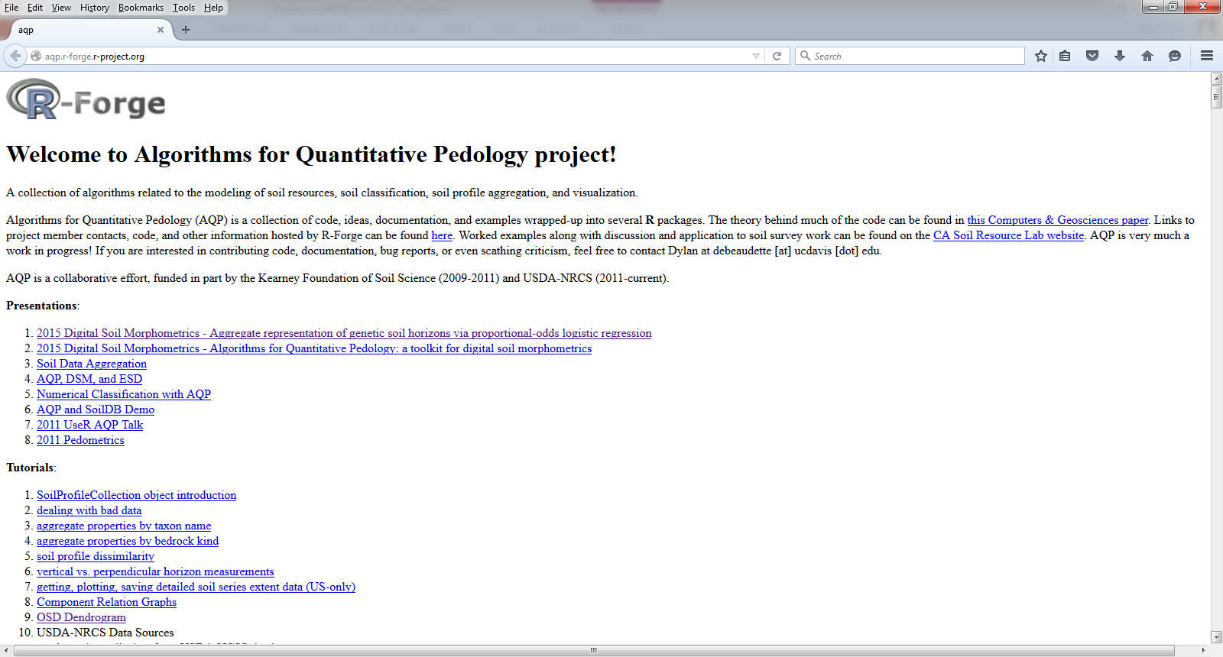
Rstudio Applications for Soil Survey
Notes:
Katey
A previous webinar presented by Dylan Beaudette, Stephen Roecker, and Jay Skovlin was published on the NRCS NCSS youtube channel in April of this year. In that webinar, they showed us how to establish an open database connection to NASIS and extract pedon data in R to create generalized horizon labels that could then be uploaded to NASIS for data correlation/aggregation. These guys, along with several other contributors, have posted well documented step-by-step instructions and examples available on the NRCS job aids page and AQP webpage. Both of those links will be listed on the last slide of this presentation.

Slide 29
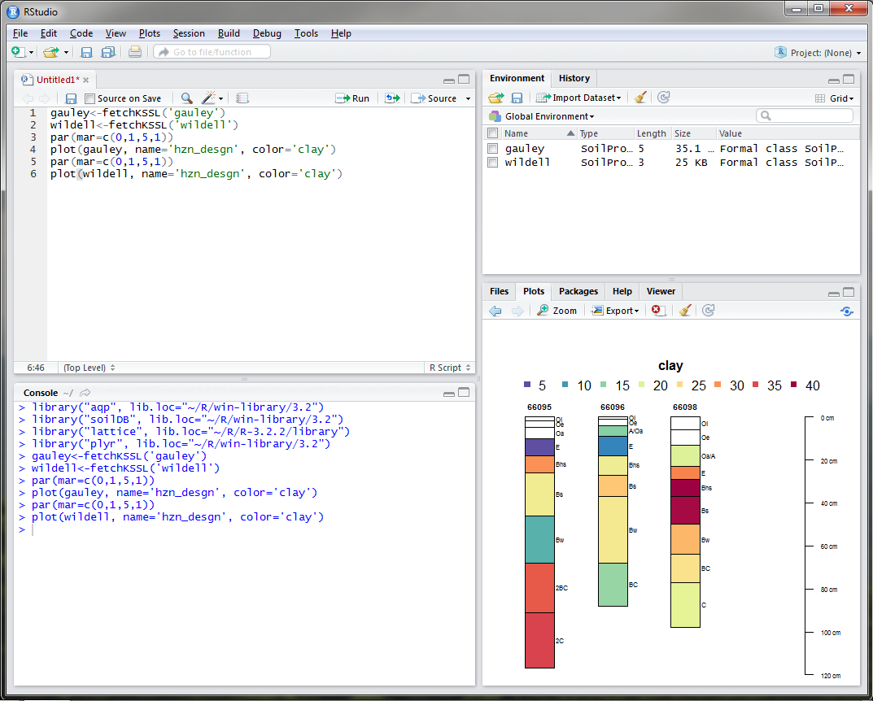
Rstudio Applications for Soil Survey
Notes:
Katey
I wanted to show you a few examples of how Rstudio has been used for soil survey applications. The first graphic here is simply a graphical display of clay content in the Wildell series obtained using the fetchKSSL command.

Slide 30
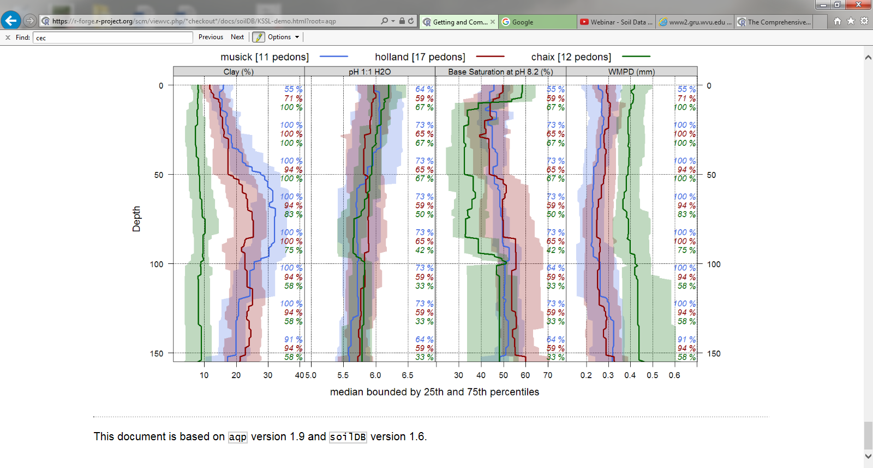
Rstudio Applications for Soil Survey
Notes:
Katey
The next graphic, generated by Dylan Beaudette, depicts a range in characteristics quantile distribution for 3 different series and 4 different soil properties also obtained using the fetchKSSL command.

Slide 31
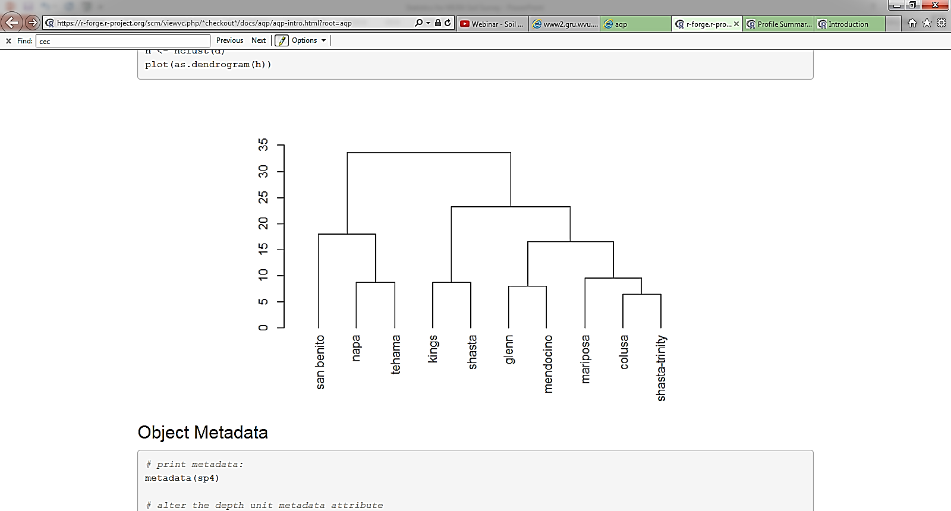
Rstudio Applications for Soil Survey
Notes:
Katey
This graphic also generated by Dylan, is a dendrogram. Dendrograms can be used to visualize dissimilarity matrix via hierarchical clustering and thus can be useful for grouping, soil correlation, and understanding of similarities between communities. Dendrograms are commonly used for analyzing ecological data.

Slide 32
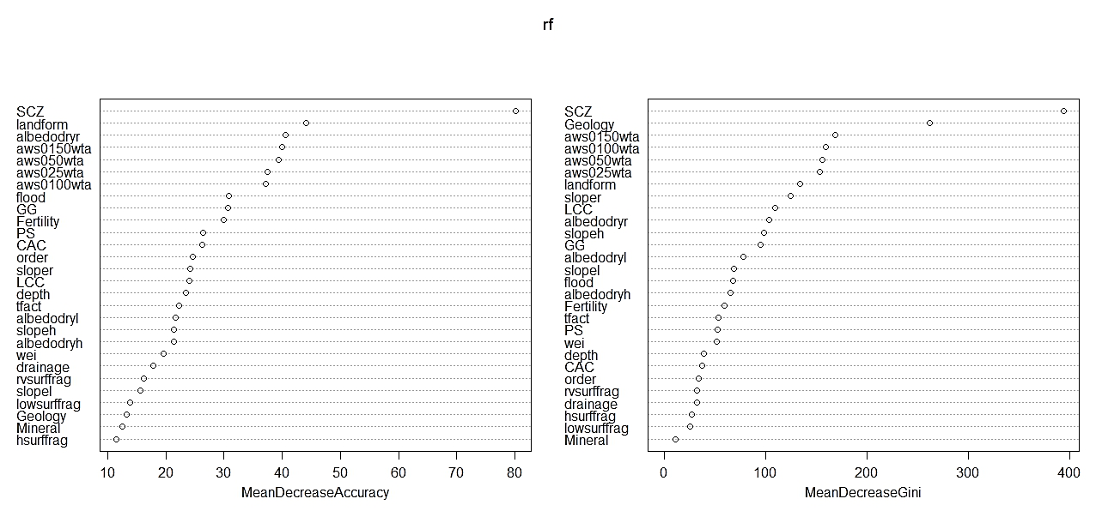
Rstudio Applications for Soil Survey
Notes:
Katey
Lastly, I want to show a variable importance plot generated from a random forest model that I used to help guide Jason Teets, our ESD specialist in Morgantown, for developing provisional ESDs. In this case, soil climate zone was the single most important variable for separating biophysical settings.
There are a LOT of uses for R within the soil science division so be on the look out for more trainings, courses, and tools.

Slide 33
Suggested NASIS Queries for Data Extraction
Pangaea query POINT - Pedon/Site/Transect by Current Taxon Name. This accepts a Taxon Name, for example, Gauley.
Pangea query POINT - Pedon/Site by Correlated Name.
Pangea query POINT - Pedon/Site/Transects by User Pedon ID (2100 Max). This accepts a comma delimited list, for example, 95IL151005E, 94IL153001, 95IL153001, 92IL163017.
Pangea query POINT - Pedon/Site/Transects by Pedon Rec ID (2100 Max). This accepts a comma delimited list, for example, 44249, 175077, 101806, 44411.
Pangea query POINT - PedonHorizon/Site/Transect by HorizonRecID (2100 Max). This accepts a comma delimited list, for example, 210618, 210619, 853291, 208951.
Notes:
Katey
In order to fetch data from NASIS, data must first be in your selected set. The NASIS queries displayed above are suggested by Tom and Stephen for loading data into your selected set.

Slide 34
Explore Your Data With R
Import table
Issue commands
Summary
Histograms
Boxplots
Evaluate
Notes:
Skye

Slide 35
Explore Data
Look at one element at a time
Like sand content
Think about the data element
Where does the data come from?
What does it represent?
Is it a fair sampling of the component?
Is there bias in how the samples were collected?
Notes:
Skye
R has some powerful packages that can do some advanced multi-variate analysis. AQP, for instance, has many tools that will help you look at properties with depth and across a landscape. R also has ways to ‘apply’ or repeat the same analysis to many different properties, components or DMUs.
For this webinar, I’m going to focus on getting started with one property………..and demonstrate how you can find and tweak more information.

Slide 36
Prep data (get it ready for R)
% Total Sand
 | Cropland |  | Rangeland |  | Pastureland
Old farm | Ap | 19 | Ap | 23 | Ap | 22
 | Bt | 21 | Bt | 34 | Bt | 23
City land | Ap | 31 | Ap | 30 | Ap | 25
 | Btk | 35 | Bt | 36 | Bt | 29
Out west | A | 27 | A | 21 | A | 23
 | Bt | 25 | Bw | 26 | Bw | 24
Notes:
Skye
Let’s think about an investigation you might do to answer a particular question/problem. In this case, we are looking at properties that might explain some observed difference in soil behavior.
You might collect data that look like this – or at least condense it to this version. Each spot/pedon has it’s own place and you’ve recorded information for each horizon.
BUT - how do we tell the computer what each of these cells mean?

Slide 37
Prep Data for R – create in Excel and save as csv (comma separated)
location | landuse | master | depth | sand
city | crop | A | 14 | 19
city | crop | B | 25 | 21
city | pasture | A | 10 | 23
city | pasture | B | 27 | 34
city | range | A | 15 | 22
city | range | B | 23 | 23
farm | crop | A | 12 | 31
farm | crop | B | 31 | 35
farm | pasture | A | 17 | 30
farm | pasture | B | 26 | 36
farm | range | A | 15 | 25
farm | range | B | 24 | 29
west | crop | A | 13 | 27
west | crop | B | 29 | 25
west | pasture | A | 11 | 21
west | pasture | B | 31 | 26
west | range | A | 14 | 23
west | range | B | 24 | 24
Notes:
Skye
In order for the computer to understand, we’ve got to make each column represent one kind of thing (think columns in NASIS or in a GIS table. I can record information about what I mean by location – what the choices are etc. And now I can point the computer to one column for each variable that I might want to analyze.

Slide 38
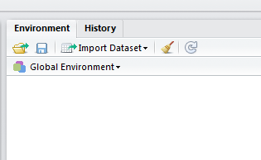
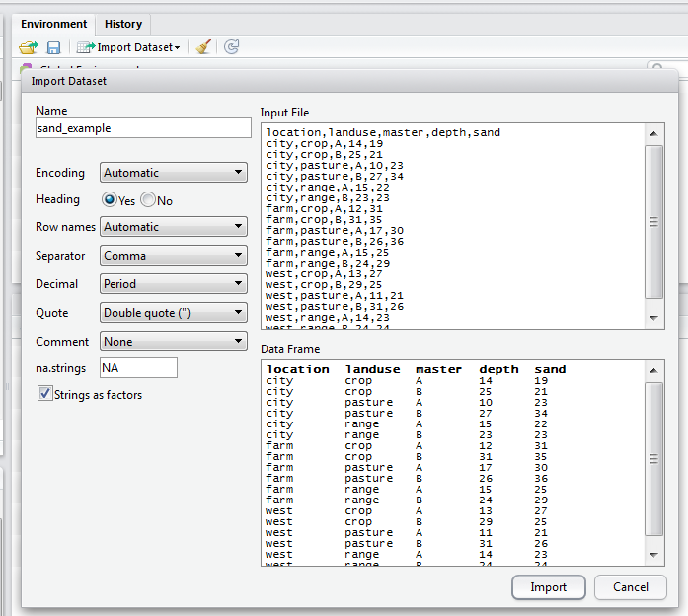
In R studio: Import sand_example.csv
Notes:
Skye
Note that I am saying yes to headers and comma for separator

Slide 39
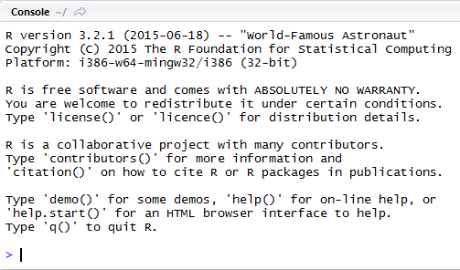
This will create and execute a command in the console window
> sand <- read.table("C:/R_data/sand_example.csv", header = TRUE, sep=",")
header = TRUE – indicates that the first line contains the column headers
sep=’,’ – indicates that commas are used to delimit or separate data elements
Notes:
Skye

Slide 40
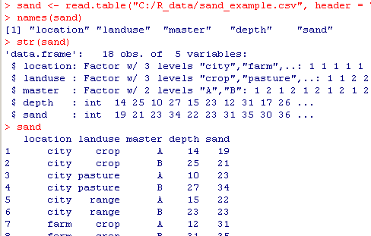
Now we can explore the dataset and any individual variable
Notes:
Skye
There are a few basic commands that we can use to learn about our dataset: names, str, or call the entire dataset (be careful with big datasets, this prints EVERYTHING!)

Slide 41
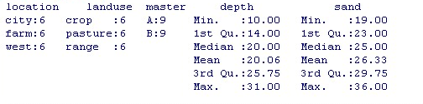
> summary(sand)
Notes:
Skye
Using summary on the entire dataset gives us info about all columns: those that are factors give us the count of each ‘level’ or option within that factor. Integer and Numeric columns have arithmetic summary.

Slide 42
> summary(sand$sand)
Min. 1st Qu. Median Mean 3rd Qu. Max.
19.00 23.00 25.00 26.33 29.75 36.00
Notes:
Skye
To refer to one particular column within a dataset use the dollar ‘$’ sign. R reads this as sand dataset, sand column. Using the summary command on just that column limits the output.

Slide 43
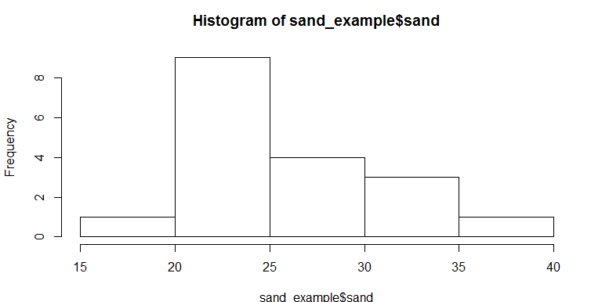
Refer to a specific column with $ >hist(sand$sand)
Notes:
Skye
hist() is the base R command for a histogram.
Without any other arguments – this sets all graph options to the default values.

Slide 44

Refer to a specific column with $ >hist(sand$sand)
Count or frequency: the number of times
values fell within each bin.
Notes:
Skye
This is good for a quick check of what is going on.
What does this tell us about the sand content? It looks like the distribution is not quite normal – there are more high values than low ones.
What if we want to customize this – change the bins or the labels?

Slide 45
Can we modify this to tell us more >?help
Usage
hist(x, ...)
## Default S3 method:
hist(x, breaks = "Sturges",
freq = NULL, probability = !freq,
include.lowest = TRUE, right = TRUE,
density = NULL, angle = 45, col = NULL, border = NULL,
main = paste("Histogram of" , xname),
xlim = range(breaks), ylim = NULL,
xlab = xname, ylab,
axes = TRUE, plot = TRUE, labels = FALSE,
nclass = NULL, warn.unused = TRUE, ...)
Arguments
Rstudio help
Notes:
Skye
This may appear a little scary – but each of these options has a specific definition (that can be googled!) and you are free to accept the default or change the options and customize your results

Slide 46
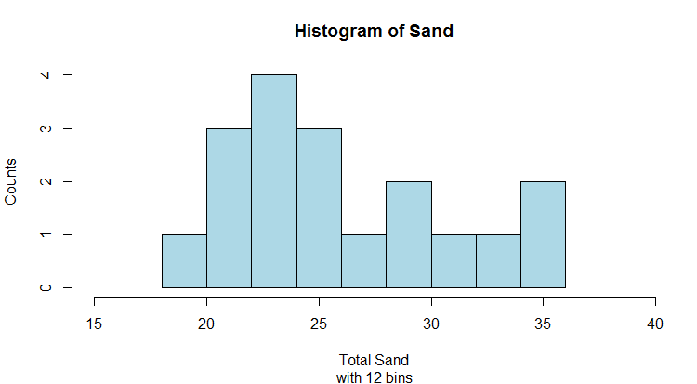
Notes:
Skye
Here – I have change the breaks, so that the ‘bins’ are different, I’ve change the x-axis limits, axis labels and the color.

Slide 47
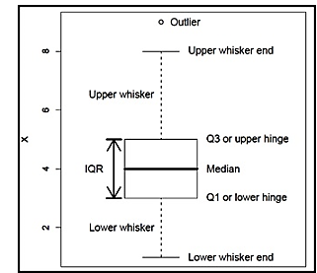
Boxplots
Notes:
Skye
Another way to display the distribution of a property is with a boxplot. It uses quartiles, so no assumption of a normal distribution is needed.
The boxplot format makes it easy to compare classes (factors).

Slide 48
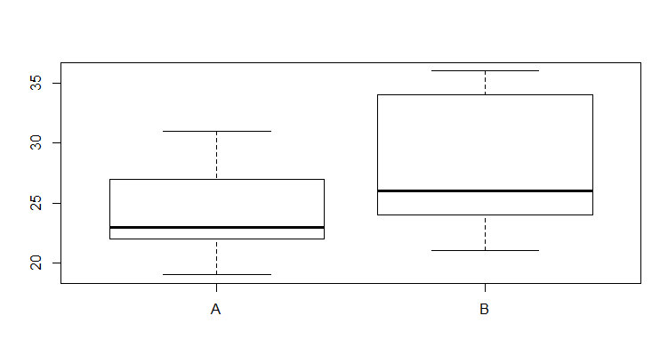
> boxplot(sand~master, data = sand)
Notes:
Skye
This command begins with a ‘formula’, x~y. You can alter the x and y in the formula and get different versions of this graph. Note that boxplot always wants a numberic variable in the x position
What does it tell you – the medians are a little different, but there is a lot of overlap.

Slide 49
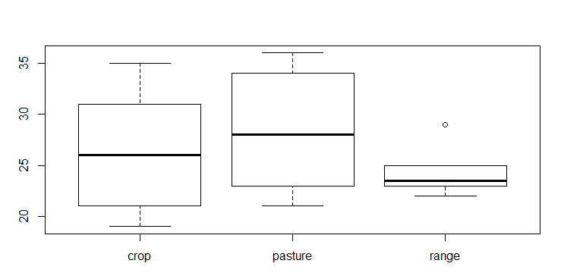
> boxplot(sand~landuse, data = sand)
Notes:
Skye
What does this graph tell you?
Are there any problems with this graph? What do I need to do to make this graph useful later.
In order to share this information, or save it for later we need more information about what the graph means.

Slide 50
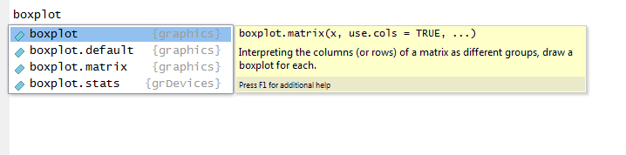
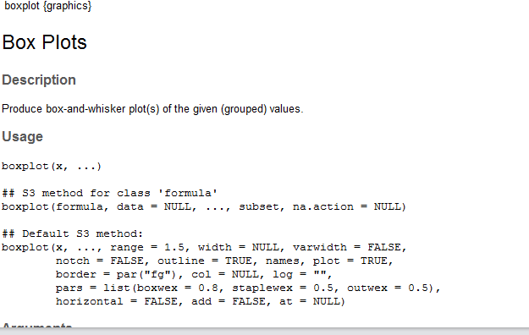
Another way to get information in R studio
As you are typing in the scripting box (upper left) – use the tab key after a command
For more help – use F1
Notes:
Skye
Within R studio – there are some tricks to getting prompts and helps on commands
Sometimes – you will still not be sure how to proceed….

Slide 51
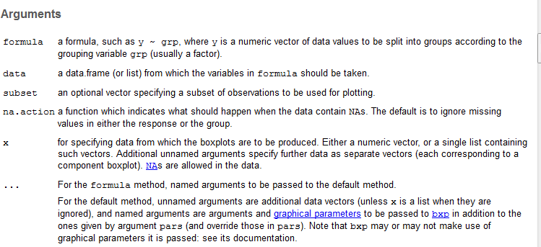
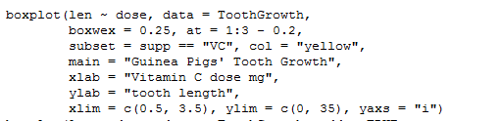
> ?boxplot
Notes:
Skye

Slide 52
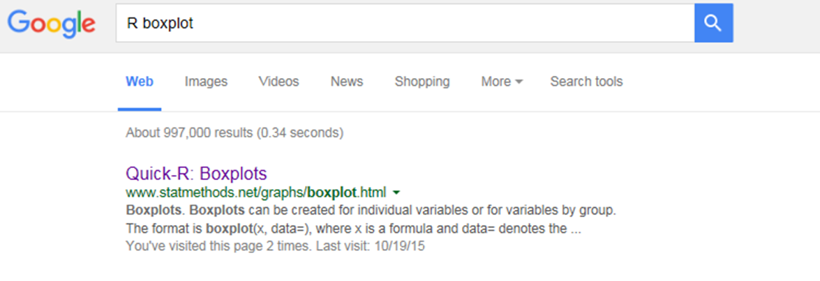
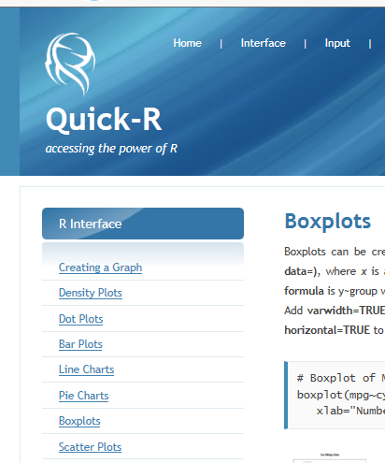
Use Available Resources
Notes:
Skye
There is a wealth of information on R on the internet. Some of my favorites are Quick-R (getting started) and Stackoverflow (specific problems)

Slide 53
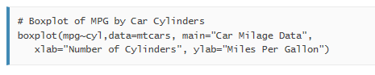

Use available resources
Many websites have examples that use data built into R
Quick-R: http://www.statmethods.net/graphs/boxplot.html
Notes:
Skye
R has some datasets loaded that will allow you to test your commands and use example scripts

Slide 54

>boxplot(sand~master, xlab="Master Horizon", ylab="Sand (%)", data=sand_example)
Notes:
Skye
Now we know enough to make our graph a little nicer and more importantly, useful.

Slide 55

Exploratory Data Analysis Using Rcmdr
Notes:
Katey
Thanks Skye. Before we conclude this webinar, I would like to show you a platform-independent basic-statistics GUI (graphical user interface) package. The R Commander package (Rcmdr) allows users to run basic statistical functions in R using drop down menus rather than command line. Rcmdr is a great way to begin acquainting yourself with R and statistics.

Slide 56



Exploratory Data Analysis Using Rcmdr
boxplot(sand~master, xlab="Master Horizon", ylab="Sand (%)", data=sand_example)
Notes:
Katey
Let’s take the sand example that Skye discussed. Say we wanted to generate a boxplot. Skye showed us to do this using the command: boxplot( ). We can also do this in Rcmdr using drop down windows. Once you load the Rcmdr package, the Rcmdr GUI will appear. You will have to import data unless you have already in R or Rstudio. To do this, simply use the drop down menu data>import data.
-Click-
To generate a box plot, use the drop down menu graphs> boxplot. Let’s plot sand by master horizon, just as Skye did in R using the command written in red at the bottom of your screen. –Click-

Slide 57

Exploratory Data Analysis Using Rcmdr
Notes:
Katey
There are many other statistical summary tools available in Rcmdr. This is a great tool for beginner R users.

Slide 58
Summary
Establish ODBC to NASIS:
https://r-forge.r-project.org/scm/viewvc.php/*checkout*/docs/soilDB/setup_local_nasis.html?root=aqp
In NASIS:
Ensure that your selected set contains the data you wish to examine in R
In RStudio:
Set your working directory
Install and/or load necessary packages (aqp, soilDB, RODBC, lattice, and Rcmdr at a minimum)
Update packages when necessary
Import data from files using the read.table ( ) command or from databases using the
fetch ( ) command
Examine data structure using the str ( ) command
Notes:
Katey
In summary, to examine soil survey data in Rstudio, you need to do a few things. You will only need to establish an open data base connection once. After that connection is established, you will need to query NASIS to create a selected set of the data you are wanting to examine. In Rstudio, you must first set your working directory, install/load packages. Remember that you only install packages once, but you load them everytime you start a new R session. Update packages when necessary. Import data using the read.table ( ) or fetch ( ) commands. Examine your data structure to ensure it was imported properly.

Slide 59
NRCS Courses Using R
Currently 3 courses:
Digital Soil Mapping Workshop*
Soil Technology – Measurement and Data Evaluation
Statistics for Soil Survey*
*New Courses
Notes:
Tom

Slide 60
Resources
NRCS Resources for R:
Previous webinar led by Dylan Beaudette, Stephen Roecker, and Jay Skovlin: https://www.youtube.com/watch?v=wD9Y0Qpv5Tw
NRCS Job Aids webpage: http://www.nrcs.usda.gov/wps/portal/nrcs/detail/soils/edu/ncss/?cid=nrcs142p2_054322
Algorithms for Quantitative Pedology: http://aqp.r-forge.r-project.org/
Working repository for R functions and workflows for processing soil and spatial data: https://github.com/ncss-tech/soil-pit
Statistics for Soil Survey: http://www2.gru.wvu.edu/~tdavello/files/stats/table_of_contents.html
Additional Resources for Learning R:
https://cran.r-project.org/doc/manuals/R-intro.pdf
http://www.statmethods.net/
http://www.gardenersown.co.uk/Education/Lectures/R/index.htm#inputting_data
http://ww2.coastal.edu/kingw/statistics/R-tutorials/
http://geog.uoregon.edu/geogr/topics/
http://wiki.stdout.org/rcookbook/
http://www.r-tutor.com/
http://www.burns-stat.com/pages/tutorials.html
Notes:
Tom

